Slide 1
Ghosts, correlations and the FRT or Much Ado About Nothing
Imants Svalbe
School of Physics and Astronomy
Monash University, Australia
imants.svalbe@monash.edu
5 Fevrier 2015

Slide 2
Topics
1 Zero sum functions (or ghosts)
2 Ghosts in image data and the Katz Criterion
3 Minimal ghosts
4 Construction of ghosts on aperiodic arrays
5 Construction of ghosts on periodic arrays
6 Constructing physical ghosts, steerable filters
7 Functions with zero cross-correlation
8 Functions with perfect auto-correlation

Slide 3
1 Zero-sum functions (or ghosts)
Nature abounds with examples of ghosts:
Salt water is electrically neutral (until you introduce anodic/cathode metals)
Atoms/molecules are neutral (before and again after they bond)
Neutrons in nuclei are neutral (1*+2/3, 2* -1/3 quarks)
The vacuum is populated the creation and annihilation of particle/antiparticle pairs (such as electrons/positrons (e⁻/e⁺) that fix the speed of light)

Slide 4
Ghosts in image data
We can play the same zero-sum games with image data
By incrementing the intensity of some pixels and decrementing the intensity of other pixels, we can make an image that has no net change in intensity when summed in given directions: these zero-sum functions are called ghosts
They play an interesting role in tomography, where we infer the structure of an object from the net absorption of, for example, light or x-rays

Slide 5
2 Ghosts in image data and the Katz Criterion A discrete projection ghost is an arrangement of pixels with values +1 and -1 placed at locations I(x, y) in a digital image so that these values project to zero (the sum is taken over all pixels in that direction)
+1
−1
Σ = 0, N = 1

Slide 6
This can be done for a pre-selected range of projection angles, here for N = 2 (0° and 90°)
+1
−1
Σ = 0
−1
+1
Σ = 0
Σ = 0
Σ = 0

Slide 7
The range of ghost angles can be incremented by dilating the negated pattern of an existing ghost at a new projection angle, here for N = 3
+1
−1
Σ = 0
−1
+1
Σ = 0
−1
+1
+1
−1
Σ = 0
Σ = 0
Σ = 0
Σ = 0
Σ = 0

Slide 8
Gray ghosts
The shift and add method of construction of ghosts creates zeros where +1 and-1 coincide
+1 and +1 can also coincide after adding ghosts to make +2 as a value of g(x, y),
-1 and -1 can also coincide to make -2 as a value of g(x, y)
Ghosts can get thicker as well as wider from repeated dilation

Slide 9
Grey ghosts
g = 0
I(x, y)
R(t, m)
The left image values* sum to zero for a wide range of projection angles (shown as the bracketed portion of the R(t, m) projection space). The object is “invisible” when looked at from any of these angles
*Grey means g = 0; whiter means more positive, blacker means more negative

Slide 10
Motivation: Why are zero projection sums interesting?
k
p
r
r
I(x, y)
R(t, m)
The p*p image space here is divided into an image area (of size p*k) and an “anti-image” area (of size r*p, shown bracketed), so constructed that the p*p FRT has zero sums for a selected range of r angles
Receiving any k of the p image rows allows exact reconstruction of the image data

Slide 11
Motivation: Why are zero projection sums interesting?
Suppose an image contains any object whose projections sum to zero over N given view angles
It is impossible to reconstruct any unique image from projections at those N angles because we can add multiple views and scaled versions of these ghosts WITHOUT CHANGING the projection data
R(t, m)
This is the basis of the Katz Criterion: an image is able to be uniquely reconstructed from N projected views if and only if the sum of the N p:q vectors is larger than the image dimensions (i.e. any ghost for those N views is too large to be added to that image. No ghosts means a unique reconstruction is possible

Slide 12
FRT Universal ghost images: N ≈ p white = +1 pixels, black = −1 pixels
a)
b)
c)
d)
a) A ghost that is invisible at all p discrete FRT projection directions, except for the horizontal sums (m = p)
b) A ghost that is invisible at all p discrete FRT projection directions, except the diagonal sums (m = 1)
c) A ghost invisible at p-1 discrete FRT projection directions, except the horizontal (m = p) and vertical sums (m = 0)
d) A ghost invisible at p-1 discrete FRT projection directions, except the +45 (m = 1) and -45 degrees (m = p-1)

Slide 13
FRT ‘universal ghosts’
This grey image has zero sum projections at all but one of the FRT angles
g(x, y) for the non-zero projection can contain large values (up to 2^{p} for a pxp image)
These ghosts are unique to the prime periodic FRT
I(x, y)
Anti-ghost based upon prime array size 67, in direction (5, 4)‏
R(t, m)

Slide 14
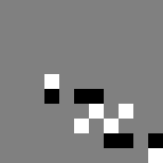
A family of equivalent ghosts for m = {1:0, 1:1, 2:1, 3:1}
Ghost values are 2, 1, -1
projection 3:1 as 6:2
projection 2:1 as 4:2
Ghosts can be made thinner (+1 white, -1 black) by spreading them out wider in image space
projection 1:1 as 2:2
projection 1:0 as 2:0

Slide 15
3 Minimal Ghosts
A minimal ghost uses the smallest possible number of pixels to create zero-sums in N directions*
Given each direction requires two pixels to make a zero-sum (+1 and a -1), then for N directions the smallest possible ghost needs to use at least 2N pixels#
*we are compiling an Atlas of Minimal Ghosts
#minimal aperiodic binary ghosts with 2N pixels exist only for N = 1, 2 3, 4, and 6

Slide 16
4 Construction of ghosts on aperiodic arrays
We apply the iterative ‘shift and invert’ method to create a ghost in N+1 directions from a ghost with N zero-sum directions
Of interest is how rapidly to ghosts grow with N and to find the smallest possible ghost for any set of N view angles
This is of interest not just because of the Katz Criterion but also to find the maximum density of zero-sum integers possible on a regular grid, i.e. the compressibility of the natural numbers (a bulk modulus for engineers)

Slide 17
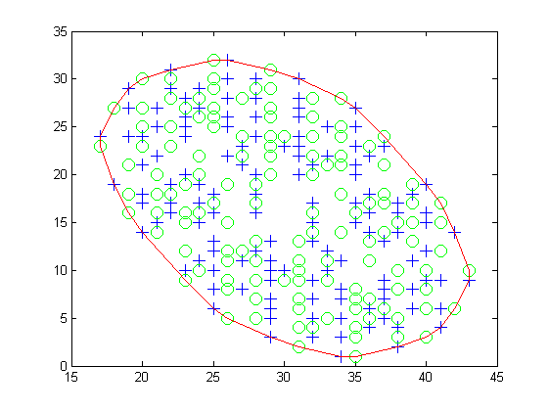
Minimal ghost examples
N = 16, # pixels: 264, max grey levels: -2/+2, mean grey level: 1.015, enclosing box size: 27x32, convex hull base area: 545, volume: 553

Slide 18
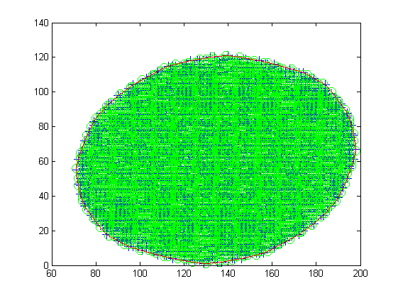
N = 40, # pixels: 33,656, max grey levels: -17/+19, mean grey level: 3.396, enclosing box size: 128x121, convex hull base area: 11645, volume: 39548

Slide 19
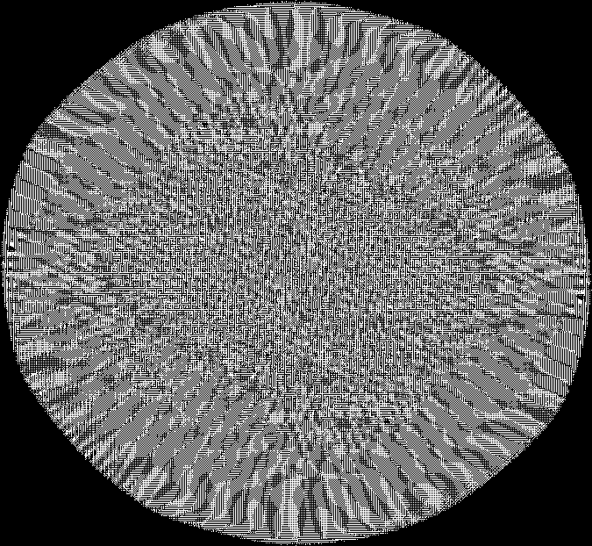
N = 120, # pixels: 1.1E10, max grey levels: -0.4M/0.4M, mean grey level: 34692, enclosing box size: 675x622, convex hull base area: 328703, volume: 1.1E10

Slide 20
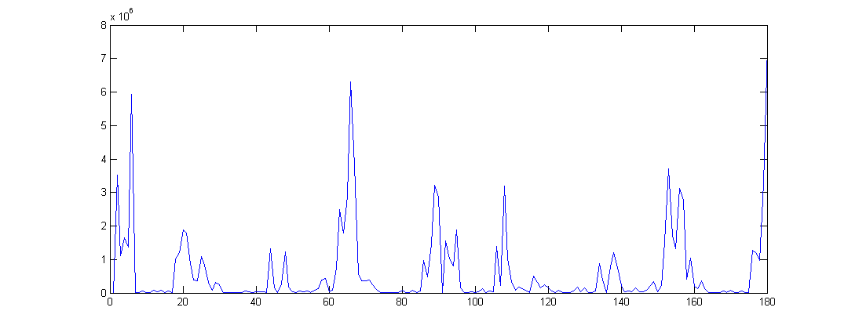
Radon projection of N = 120 ghost
max(abs(Radon(N120)))
Projection angle (0° to 179°)

Slide 21
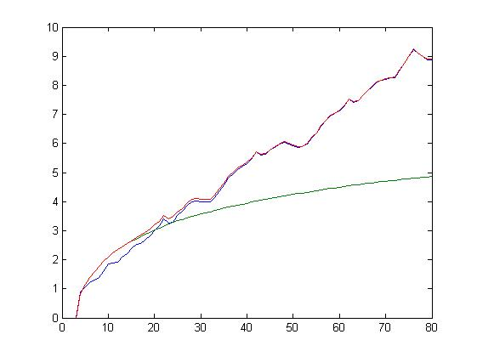
Ghost volumes for N=8 to N=80 p:q view angles ordered by min(|p|+|q|)
Log(ghost volume)
N

Slide 22
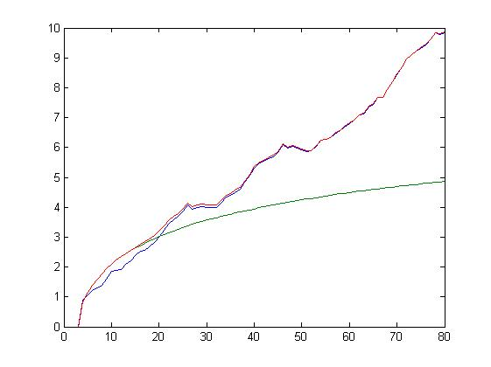
Ghost volumes for N=8 to N=80 p:q view angles ordered by min(p²+q²)
Log(ghost volume)
N

Slide 23
Minimal ghost volumes for N= 8 to 80 are about 2 orders of magnitude smaller than those for ordered p:q sets

Slide 24
5 Projection angles and their Haros/Farey a:b values
(0, 0)
r₁ r₂
θ = 90°
15:1
7:2
θ = 0°
θ = 45°
The 2D Farey points, (m, n): gcd(m, n) = 1. The light grey Farey points here lie between gradients 15:1 and 7:2. We select either light grey or dark grey points from this lattice to synthesize discrete Radon band-pass filters. We use discrete projection vectors of length less than some radius r₁, or those that have lengths between r₁ and r₂

Slide 25
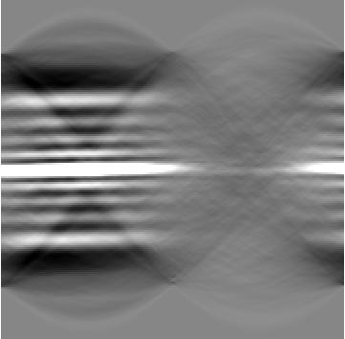
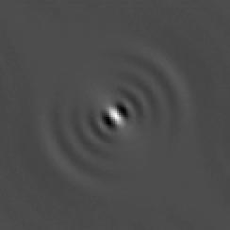
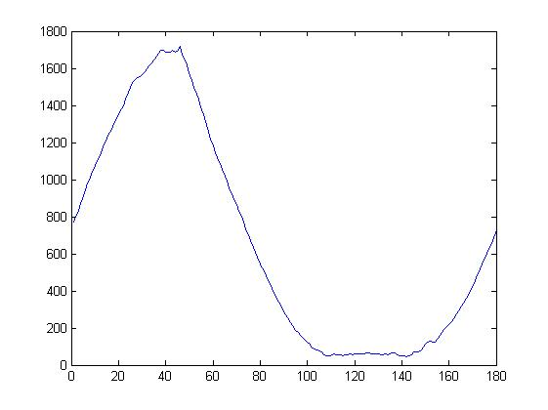
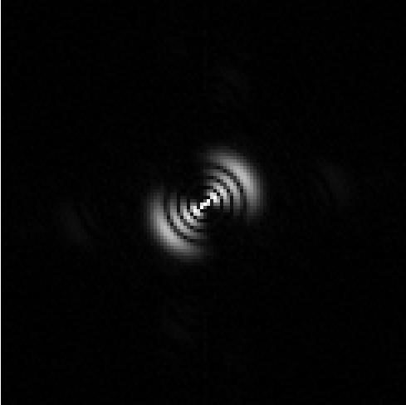
Oriented functions in ‘continuous’ space
Left: An oriented Laguerre-Gauss function of fourth order, below: The magnitude of the Fourier transform, centred zero frequency
Right: The equal angle (1 degree stepped), “continuous” Radon transform, R(ρ, θ) of the shape at top left, below, The maximum of the absolute value of the Radon space, plotted as a function of the projection angle, θ

Slide 26
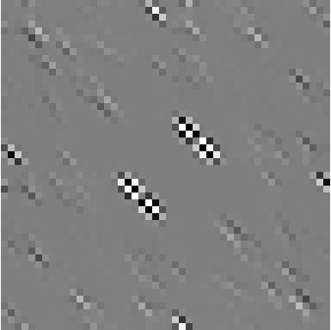
Oriented zero-sums: Example 1, shown in real and FFT space
I(x, y)
abs(F(u, v))
real(F(u, v))
imag(F(u, v))
Top Left: A ghost shape with a 48x48 pixel footprint, intensity -32 ≤ g ≤ 32, made from discrete projections using the 19 shortest vectors that vanishes when projected over the discrete angles. Positive values are white, grey is zero and black is negative. Zero frequencies are centred

Slide 27
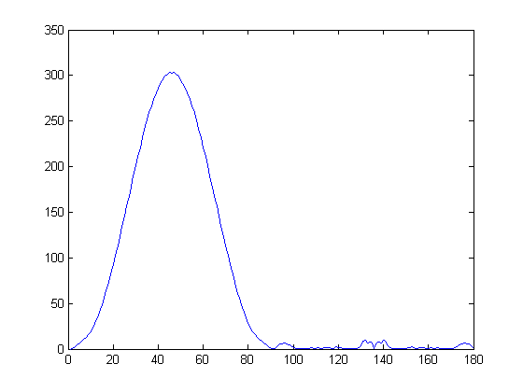
Radon projection of discrete ghosts
R(ρ, θ)
θ
Left: The “continuous” Radon projective transform, R(ρ, θ), of the previous shape
Right: The maximum of the absolute value of R, plotted as a function of the projection angle, θ. Note the small, but non-zero oscillations above 90°(arrowed)

Slide 28
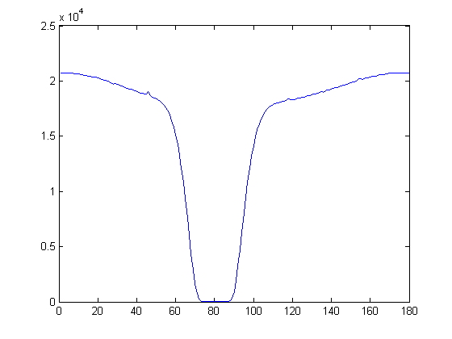
2nd discrete example:
R(ρ, θ)
θ
Left: g(x, y) made from the 50th through to the 70th shortest vectors covering the angle range 74-86° (using vectors 23:2 to 27:7). The intensity ranges from -1102 to +1102. The footprint of this ghost is 447x85 pixels, below: the magnitude of the Fourier transform, zoomed, centred zero frequency
Right: The equal angle, “continuous” Radon transform, R(ρ, θ) of the shape at left; below: the maximum of the absolute value of the Radon space from plotted as a function of the projection angle, θ

Slide 29
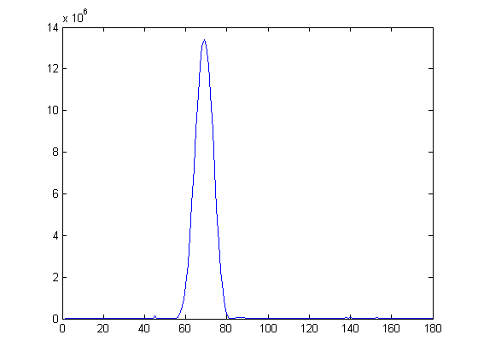
Example 3: narrow Radon pass-band
R(ρ, θ)
g(x, y)
θ
Left: Filter shape g(x, y) synthesized from the unweighted set of the 50 shortest vectors covering the angle range 59-74° (gradients of 7:2 to 5:3 in the Farey plane). The grey level range here spans -290,000 < g < +290,000 and the footprint of this ghost occupies 160x185 pixels
Right: The Radon image R(ρ, θ), below: the maximum absolute value of R as a function of angle, 0 ≤ θ <180°

Slide 30
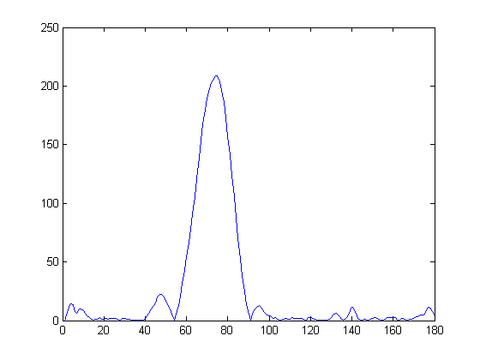
Functions with low grey level range
R(ρ, θ)
θ
g(x, y)
Left: Filter shape g(x, y) synthesized from the unweighted set of the 19 shortest vectors covering the angle range 59-74° (gradients of 7:2 to 5:3 in the Farey plane). The grey level range here is -18 < g < +18 and the footprint of this ghost occupies 39x46 pixels
Right: The Radon image R(ρ, θ) of the left shape. The maximum absolute value of R as a function of angle, 0 ≤ θ <180°

Slide 31
6 Construction of ghosts on periodic arrays
Work by Normand/Svalbe* showed it is possible to generate truly minimal ghosts, i.e. place N pixels with value +1 and N pixels of value -1 to achieve N zero-sum directions, on periodic arrays of size p*p where p > N
This method relies on each value of +1 lining up with N pixels of value -1 for each of the N directions on the wrapped array, i.e. we exploit the periodic boundary conditions
*see DICTA 2010, DGCI 2011

Slide 32
Minimal ghosts (N= 12) and their FRT
t
m
Left: A 23*23 image space I(x, y), containing twelve +1 pixels (white) and twelve −1 pixels (black)
Right: The 23*24 discrete projections, R(t, m), of the image at left
The projection values at 12 distinct angles (m = 0, 3, 7, 8, 9, 10, 13, 16, 17, 18, 19, 23) have the value zero (shown here as grey)

Slide 33
Symmetry of minimal ghosts: 17*17 array
Left: N = 8, x_{i} = 8 for C₀ = (1, 4) Right: N = 9, x_{i} = 3 for C₀ = (1, 5)
Lines joining paired ghost pixel locations are shown. The N lines are all perfectly bisected at a single point of symmetry, located here at (p/2, p/2)
The position of two pixels have been wrapped to the opposite edge of the array, modulus p (shown by the boxes) to complete the symmetry

Slide 34
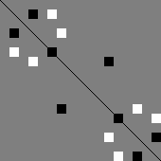
Symmetry, translation and affine transformation N = 8 ghost images for x_{i} = 8, p = 17
Left: C₀ = (1, 0) (red circle) produces odd symmetry about the leading diagonal*
Right: C₀ = (1, 5) (blue circle) makes the ghost image have even symmetry*
Ghost images are invariant to translation (modulus p)
Wrapped, shifted and scaled (by +g and –g) versions of the above images are still ghost images at the same N angles
Affine rotations of these ghosts produce ghost images at N new FRT angles
*some choices of C₀ can lead to degenerate ± pixel positions

Slide 35
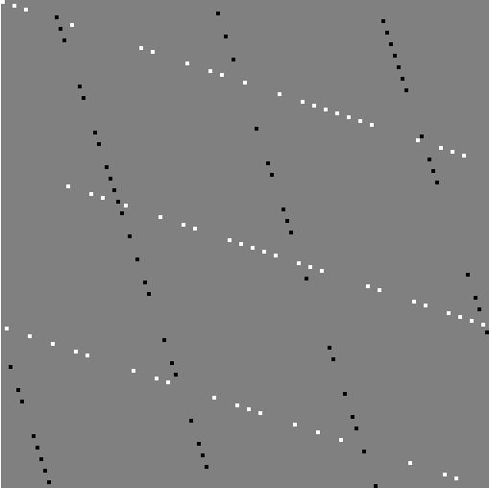
Minimal ghost examples: 127 x 127 images, 126 pixels, zero-sums at N = 63 projection angles
Left: a ghost that is maximally visible at 2 angles, invisible at 63 angles
Right: a ghost with minimal visibility at all projection angles

Slide 36
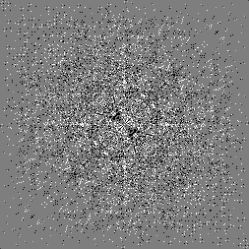
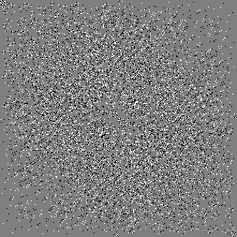
Auto- and cross-correlation of minimal ghost images
Two different ghost images for N = 64, p = 127
Each auto-correlation has a single pixel peak value of 128 at (127, 127), point shown circled, other locations have absolute values ≤ 2
The cross-correlation of the two ghosts above has values +1, 0 or −1

Slide 37
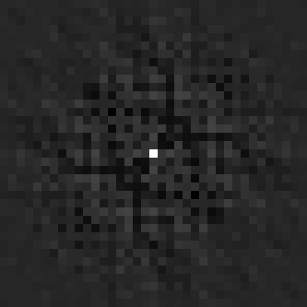
Four non-overlapped ghost images
The sum of four, non-overlapping ghost images with N = 5 for p = 19 (marked by red circles). These are all anti-symmetric ghosts with the same zero-sum angles
The auto-correlation peak value at (19, 19) is 80 (20 from each of the four independent ghost components). The off-peak values range from +10 to −14. The cross-correlation of the above ghost with its transpose has the same range of values, but with reversed signs

Slide 38
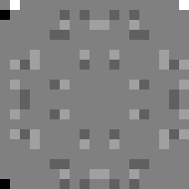
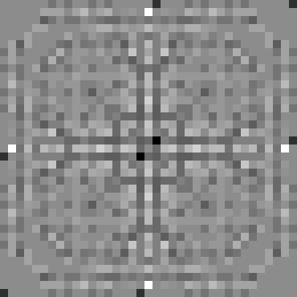
Four overlapped ghosts
The sum of four, partially-overlapping ghost images with N = 5 for p = 19 constructed with the same starting coordinate, C₀ = (1, 0) (shown by the red circle)
The summed ghost has value +4 at (1, 0) and (18, 0) and −4 at (0, 1) and (0, 18). All four ghosts are anti-symmetric, but have different zero-sum angles
The auto-correlation peak value at (19, 19) is 128 = 4*4*4 + 16*4*1, has been suppressed to better show the off-peak values, which range from +20 to −24

Slide 39
7 zero cross-correlation functions
The cross-correlation of two functions (like a convolution) measures how similar they are
A correlation in real space is equivalent to a product of the two Fourier transforms
We can use the FRT to produce sets of data A and B that have zero cross-correlation by aligning the N projections that have zero sums for A with N non zero-sum projections for B

Slide 40
Constructing functions A and B that have exactly zero cross-correlation
The product of the FFT of individual 1D projections of the FRT is equivalent to a 2D correlation in FFT space
As each row-wise product is zero, the 2D cross-correlation A⊗B must be exactly zero
FRT
*
FRT of Image A has zero FRT projections from 0 to (p-1)/2
FRT of Image B has zero FRT projections from (p+1)/2 to p
Image
⊗
Image A
Image B

Slide 41
Example:
Top: A and B are 19 × 19 arrays I(x, y), each comprised of 10 +1 (white) and 10 −1 (black) elements, placed to have zero-sums along 10 distinct discrete directions. A⊗B = 0
Bottom: FRT R(t,m) of the arrays A and B. Note the sets of zero-sum angles (shown in grey) for A and B are complementary
A
B
FRT(A)
FRT(B)

Slide 42
Application of zero-cross functions
If arrays A and B have strong auto-correlation, (and ghost functions generally do) then they can be used as watermarks to insert into data to provide ownership verification and data security
As A and B have zero cross-correlation, they can be embedded concurrently in the same data without interacting with each other

Slide 43
8 Perfect sequences and perfect correlations
A perfect sequence is a1D string where the auto-correlation peak value is equal to the sequence length and is exactly zero elsewhere*
A 2D N*N perfect array has a peak auto-correlation value of N² at one location and is zero elsewhere
Perfect sequences are rare and hard to construct, especially in 2 and higher dimensions
*the related pseudo-noise arrays have a zero image sum and auto-correlation peak N² -1 with a constant off-peak value of -1

Slide 44
Example: 17x17 perfect/pseudo-noise array
1 -1 1 1 1 -1 -1 -1 -1 1 -1 -1 1 1 1 -1 1
1 1 -1 1 -1 1 -1 -1 1 -1 1 1 1 -1 -1 -1 1
-1 1 1 -1 1 -1 -1 -1 1 -1 1 1 1 1 -1 1 -1
1 1 -1 1 -1 1 1 -1 -1 -1 -1 -1 1 1 1 1 -1
-1 1 1 -1 1 -1 1 1 -1 1 1 1 1 -1 -1 -1 -1
-1 -1 -1 1 -1 1 1 -1 -1 1 -1 1 1 1 1 -1 1
-1 -1 1 -1 1 -1 1 1 1 -1 -1 -1 1 1 1 -1 1
-1 -1 -1 1 1 1 -1 1 1 -1 1 1 1 -1 -1 1 -1
-1 1 1 1 -1 -1 -1 1 1 1 -1 1 1 -1 -1 1 -1
-1 1 -1 -1 1 -1 -1 1 1 1 1 -1 1 1 1 -1 -1
-1 1 1 1 -1 1 -1 1 -1 -1 1 -1 1 -1 -1 1 1
1 1 -1 -1 -1 1 -1 1 -1 -1 -1 1 1 -1 1 1 1
-1 -1 -1 -1 -1 -1 -1 -1 -1 -1 -1 -1 0 -1 -1 -1 -1
1 -1 1 -1 -1 -1 1 1 1 1 1 -1 1 1 -1 -1 -1
1 -1 1 -1 1 1 1 -1 1 1 -1 -1 1 -1 1 -1 -1
1 -1 -1 1 -1 -1 1 -1 -1 -1 1 1 1 -1 1 1 1
1 -1 -1 -1 1 1 1 -1 -1 1 -1 -1 1 1 -1 1 1

Slide 45
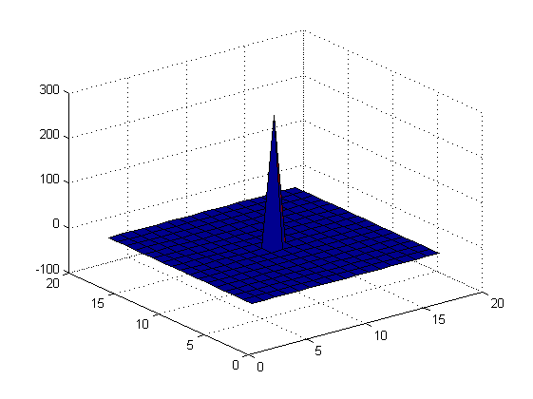
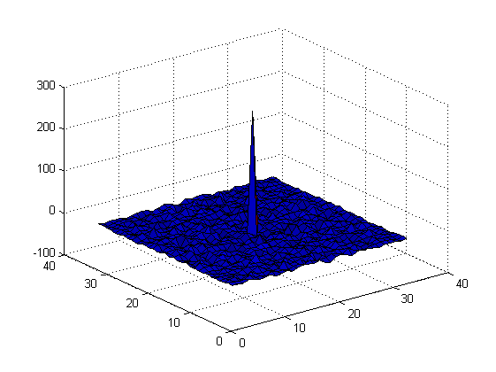
Periodic and aperiodic auto-correlations of previous array
Periodic auto-correlation Peak = 288, off-peak = -1
Aperiodic auto-correlation Peak = 288, merit factor 3.3

Slide 46
Mojette projections preserve 2D auto-correlations*
(2P-1)*(2Q-1) auto-correlation
P*Q image
2D A/C
Mojette⁻¹
Mojette
Mojette⁻¹
Mojette
1D A/C
1D Katz-sufficient Mojette projection set
1D auto-correlations of Katz Mojette projections
*Olivier Philippé, PhD Thesis, Nantes, 1998, or see Mojette Book, p. 52

Slide 47
Mojette projections and perfect auto-correlations
2D perfect auto-correlation
2D P*Q perfect image
2D A/C
Mojette⁻¹
Mojette
Mojette⁻¹
Mojette
1D A/C
1D Katz-sufficient Mojette projection set
1D perfect auto-correlations

Slide 48
Construction of perfect arrays
We can use the above property to construct p^{n} perfect arrays from perfect FRT rows in 1D, for n > 1 and any size p
We can construct large families of orthogonal arrays that have perfect periodic auto-correlation, maximal aperiodic correlation and minimal cross-correlation between all family members
*work done with Benjamin Cavy from Nantes and Andrew Tirkel from Melbourne, in review, Electronic Letters, 2015

Slide 49
Example 17x17 perfect grey array
2 -15 2 2 19 19 2 -15 2 -32 2 19 2 19 19 19 -32
19 2 2 -32 -15 -15 2 19 -32 19 19 19 19 -15 2 2 19
2 2 2 -32 19 2 2 -49 19 19 19 -15 2 19 19 -15 19
19 -15 2 19 19 -32 -32 19 -32 2 -15 2 19 19 2 19 19
2 -15 2 2 2 -49 -15 -32 2 2 -32 2 -32 -32 -15 -32 -15
2 -15 -32 2 2 19 -32 19 -15 2 2 19 19 19 2 19 2
2 2 -32 2 19 19 -32 19 19 -49 19 2 -15 19 19 19 2
2 19 2 19 19 2 2 2 19 19 -32 -49 19 -15 19 -15 2
19 2 2 2 -15 2 -15 19 -32 19 2 -15 19 19 2 2 2
-15 2 19 19 2 19 -15 -15 19 19 2 2 -15 2 -15 19 -15
19 19 2 -15 -32 2 2 -15 19 -15 2 19 19 2 2 19 -15
-15 2 2 19 -32 2 2 19 19 2 2 19 19 2 -15 -15 2
-15 19 2 2 19 2 -32 19 19 19 2 2 2 2 2 -32 2
-15 19 19 2 19 19 -15 -15 -15 2 19 2 2 2 -15 2 2
2 19 19 2 -15 2 -49 19 19 -15 2 19 -15 -15 2 19 19
-15 -15 19 19 2 19 -32 19 2 19 19 -15 -32 2 2 2 19
19 2 2 2 2 2 2 2 2 2 2 2 2 -15 2 2 2

Slide 50
Periodic and aperiodic auto-correlations of grey 17x17 perfect array
Periodic auto-correlation peak = 289, off-peak = 0
Aperiodic auto-correlation peak = 289, crest factor 2.8, merit factor 3.2

Slide 51
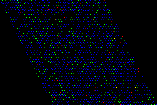
Summary
Ghosts have found many diverse applications in image reconstruction and image processing, information storage and transmission
The FRT provides a bridge between the aperiodic domain of Mojette and periodic structures, which often have optimal properties
Acknowledgments: Nicolas Normand, Jeanpierre Guédon, Andrew Kingston, Shekhar Chandra, Benjamin Cavy, Andrew Tirkel
*background image is a perfect auto-correlation grey hexagonal array

